Slide 1

ecology
March 19th, 2021
Isra Satiar

Slide 2
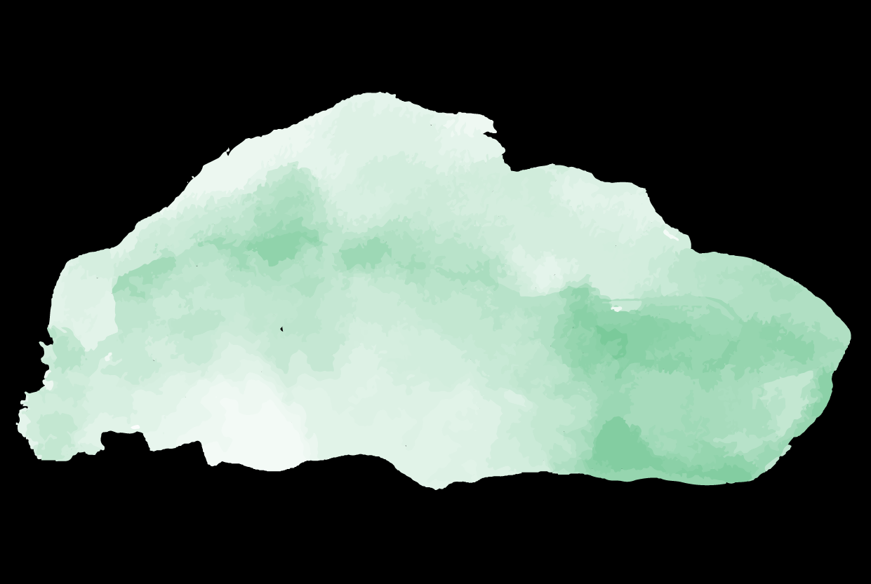
Overview

Slide 3
Basic Terms
Ecology: study of interactions between organisms and the environment
Environment: abiotic + biotic factors
Subdivision
Organismal Ecology: how an organism’s structure, physiology, and behavior meet challenges from its environment
Population Ecology: factors that impact population size
population: same species in an area
Community Ecology: interactions between species (predation, competition)
community: all organisms of all species in an area
Ecosystem Ecology: energy flow and chemical cycling among biotic + abiotic
ecosystem: all abiotic factors + entire community of species
Landscape Ecology: energy exchange across series of connected ecosystems
Global Ecology: biosphere

Slide 4
Climate
Climate: long term weather conditions in an area
temperature, precipitation, sunlight, wind
Scales
Macroclimate: patterns on a global, regional, local level
Microclimate: very fine patterns (ex: fallen log)

Slide 5
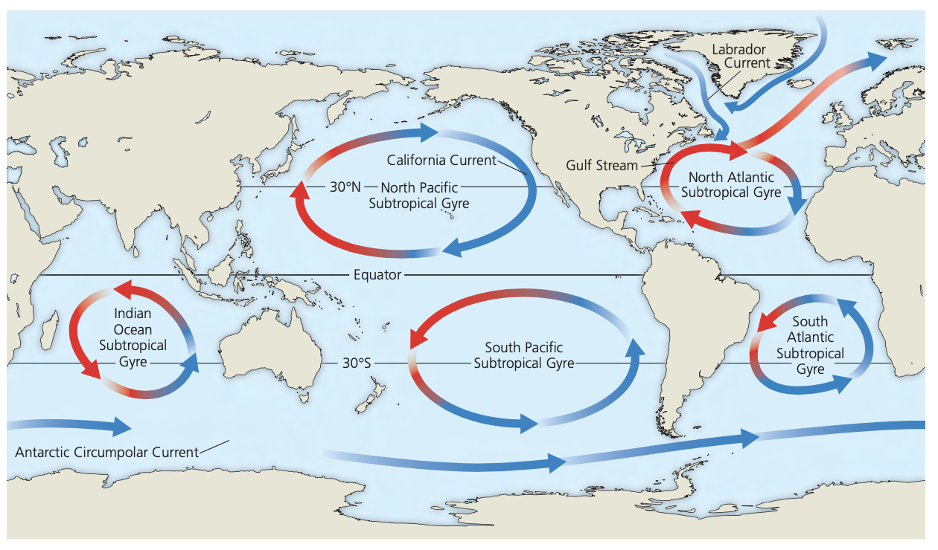
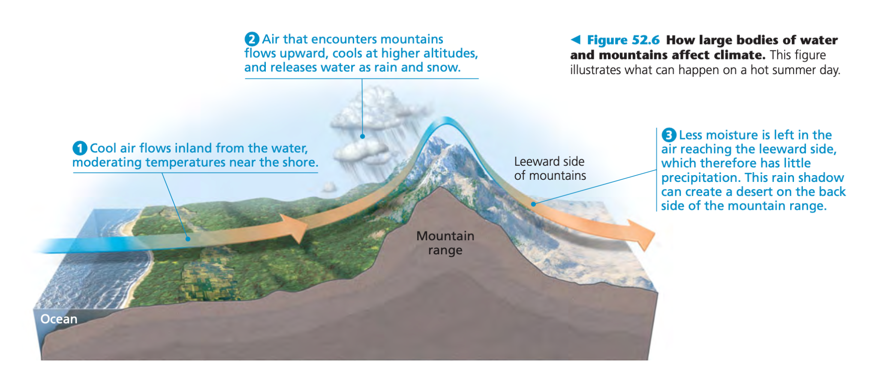
Factors that impact macroclimate
Ocean currents
Mountains

Slide 6
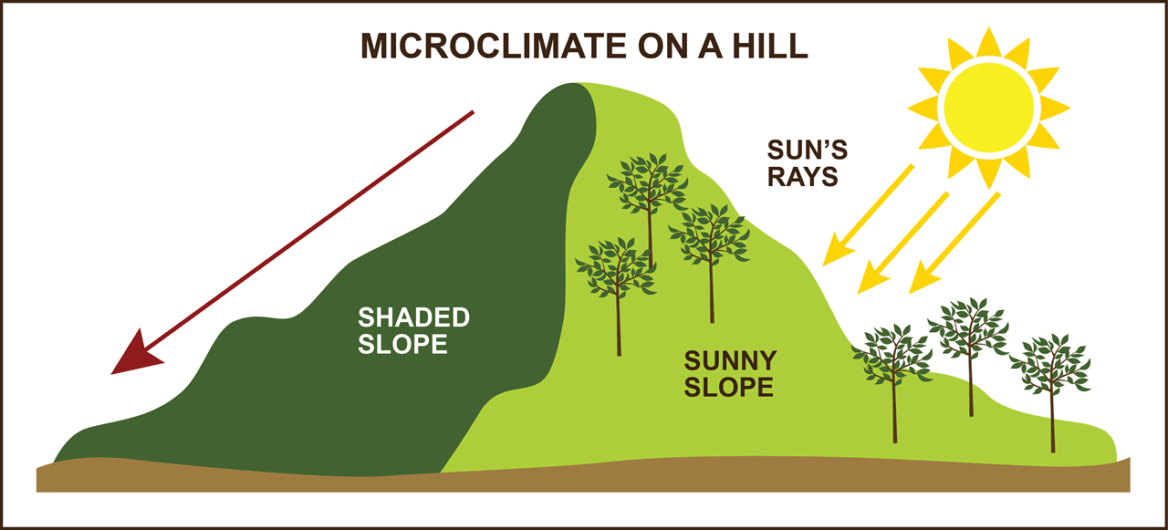
Factors that impact microclimate
Protection by other abiotic factors → casting shade
Evaporation from soil
Wind patterns

Slide 7
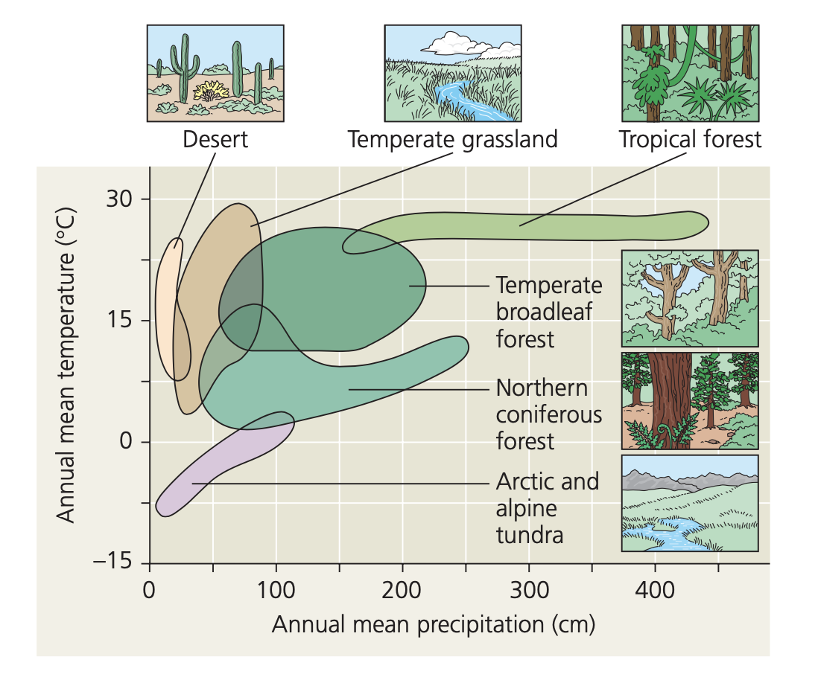
Climograph
Plot of temperature and precipitation in particular region

Slide 8
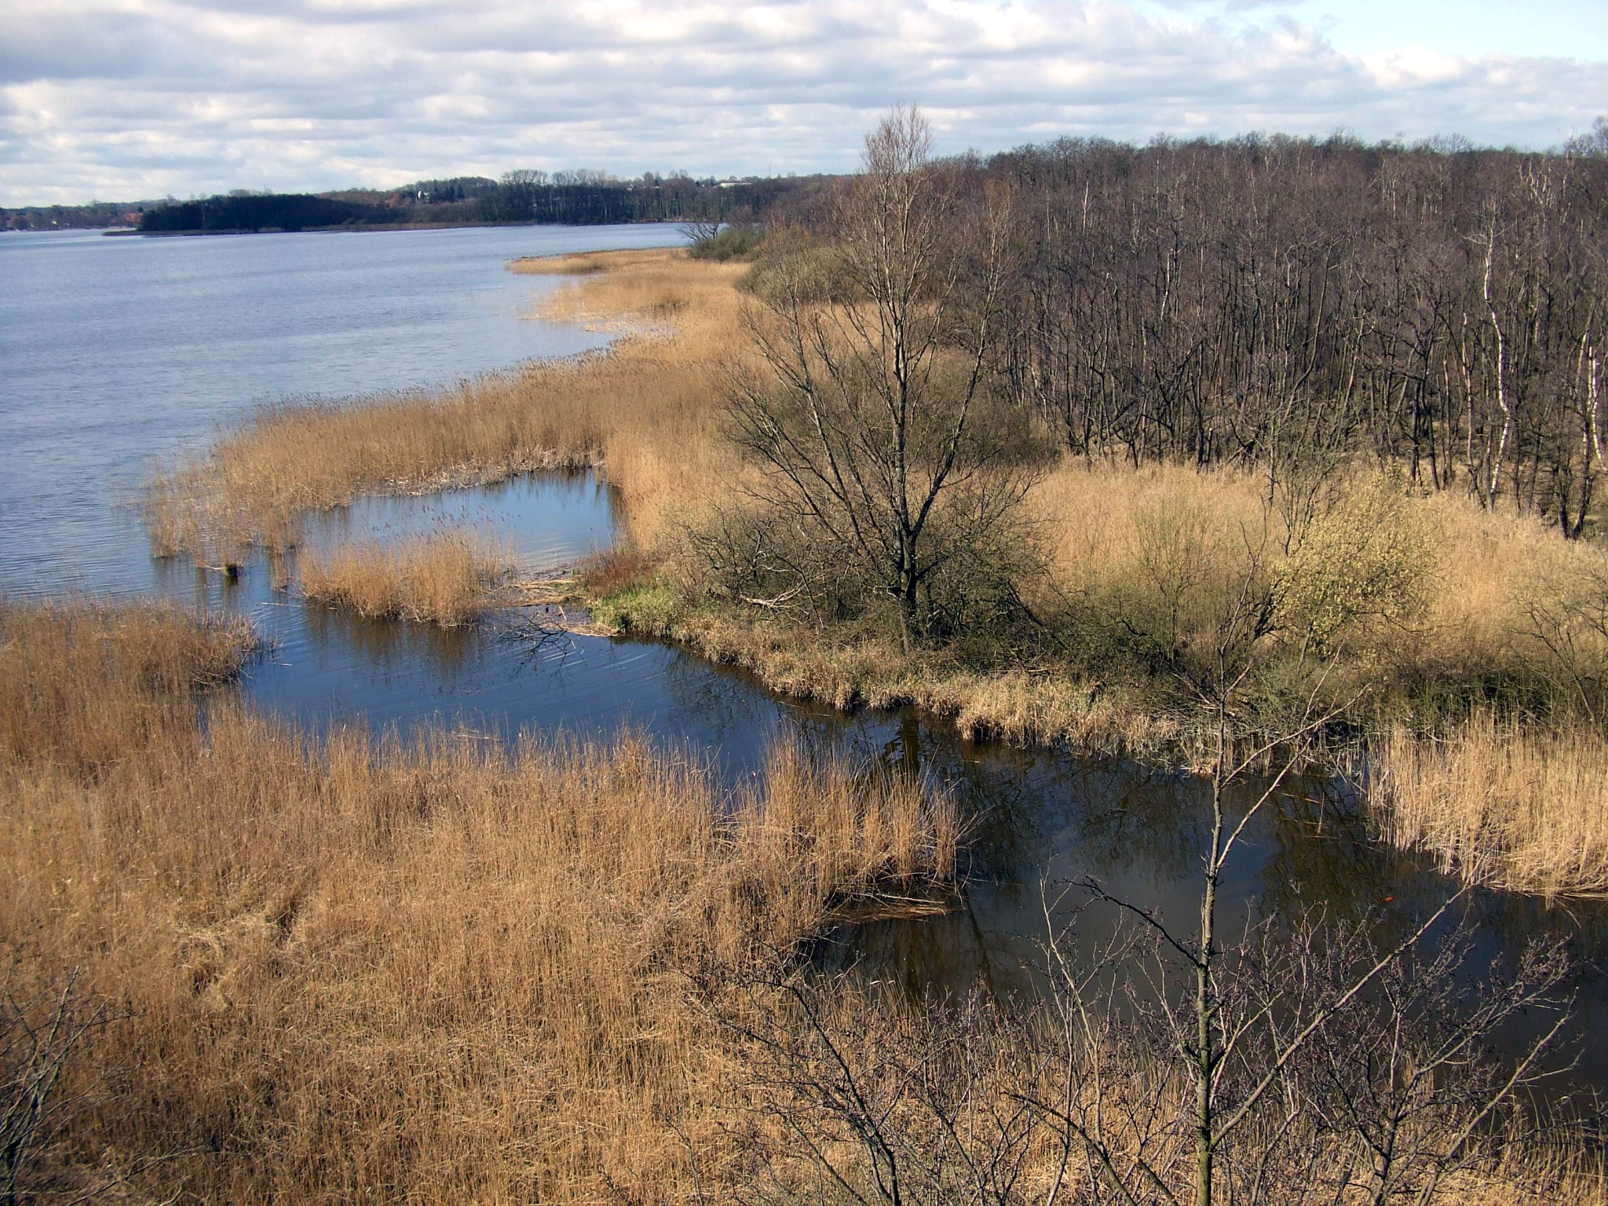
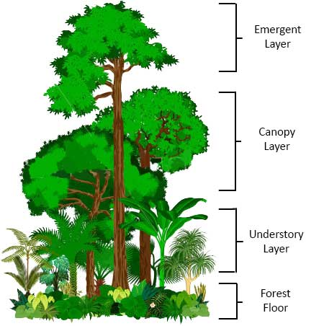
Biome terminology
Ecotone: area of transition between two biomes
Layers of forests: emergent, canopy, understory, forest floor
Disturbance: storm, fire, human activity that changes a community

Slide 9
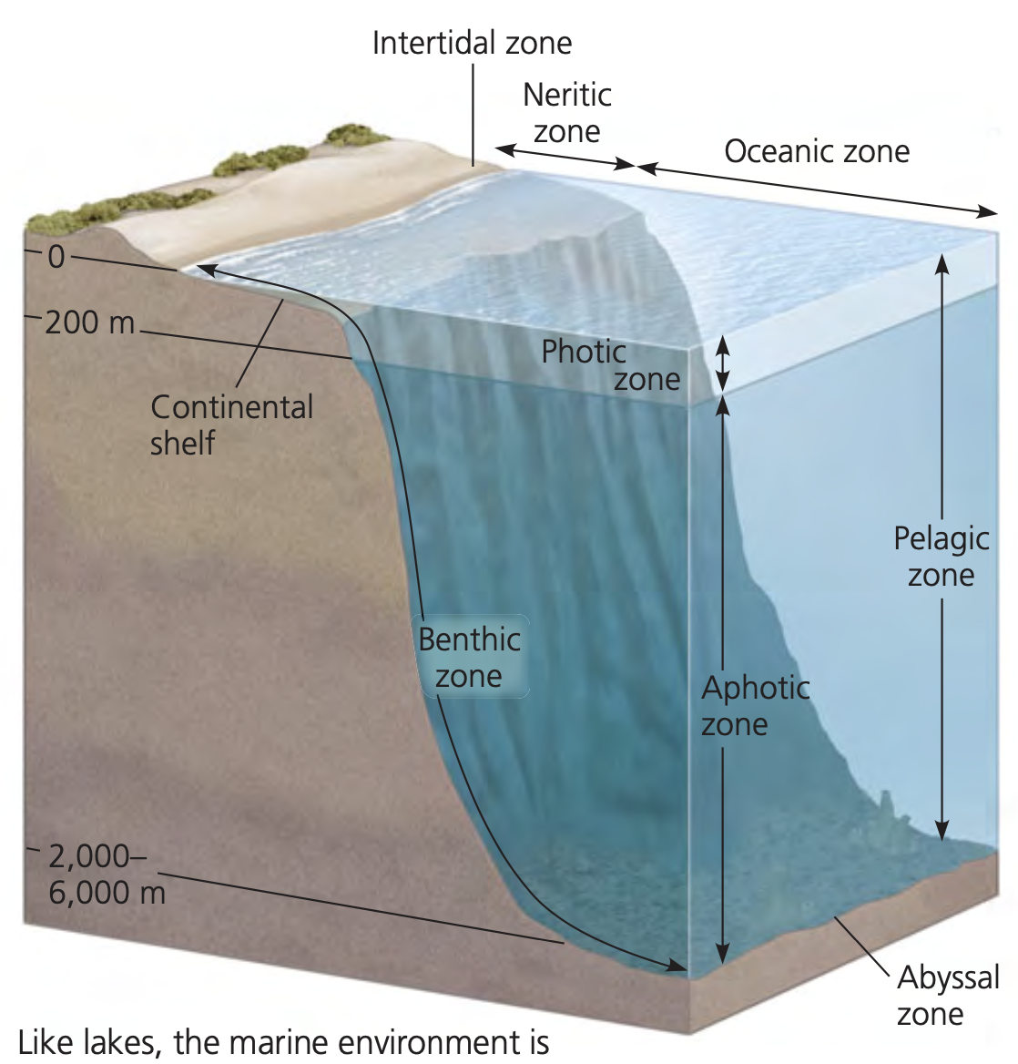
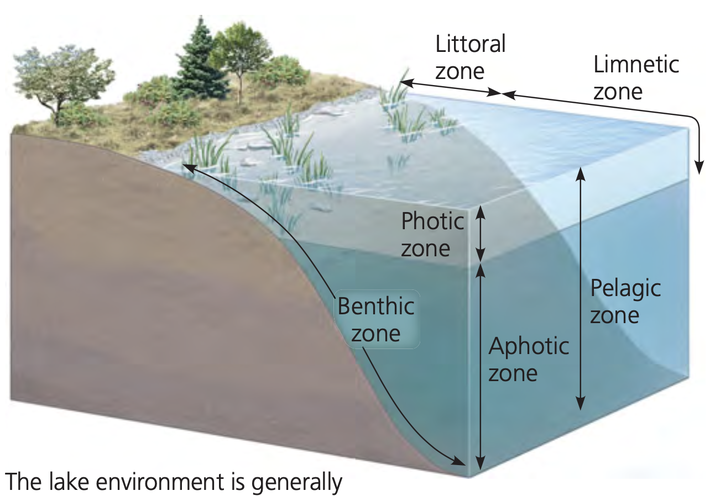
Zonation
zonation in a lake
marine zonation

Slide 10
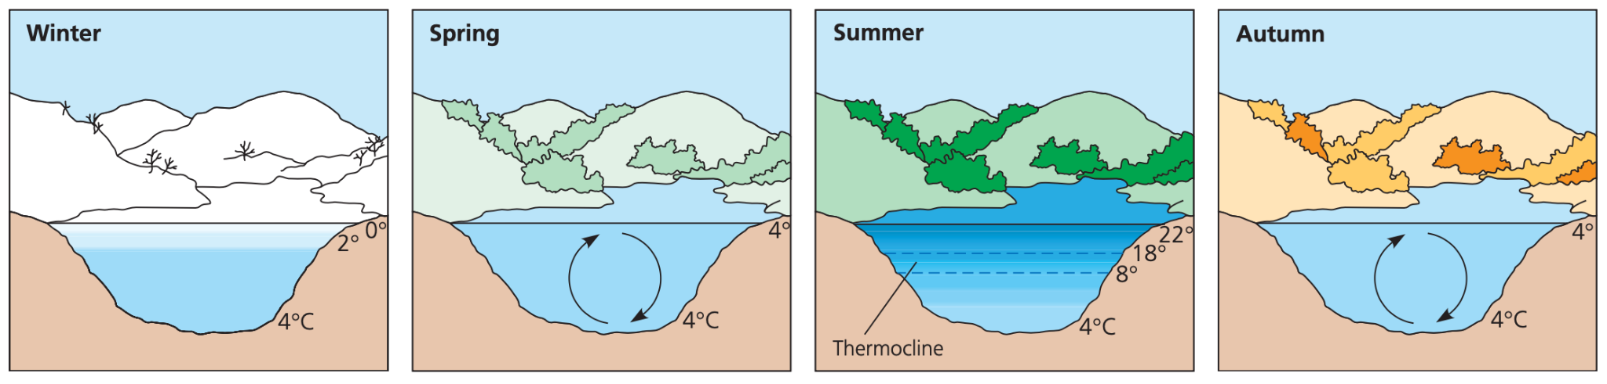
Turnover
Thermal stratification: lake develops into two layers of water (top warm, bottom cold)
Turnover: changing temperature profiles
oxygenated water from top → bottom
nutrient rich water from bottom → top

Slide 11
Population Ecology

Slide 12
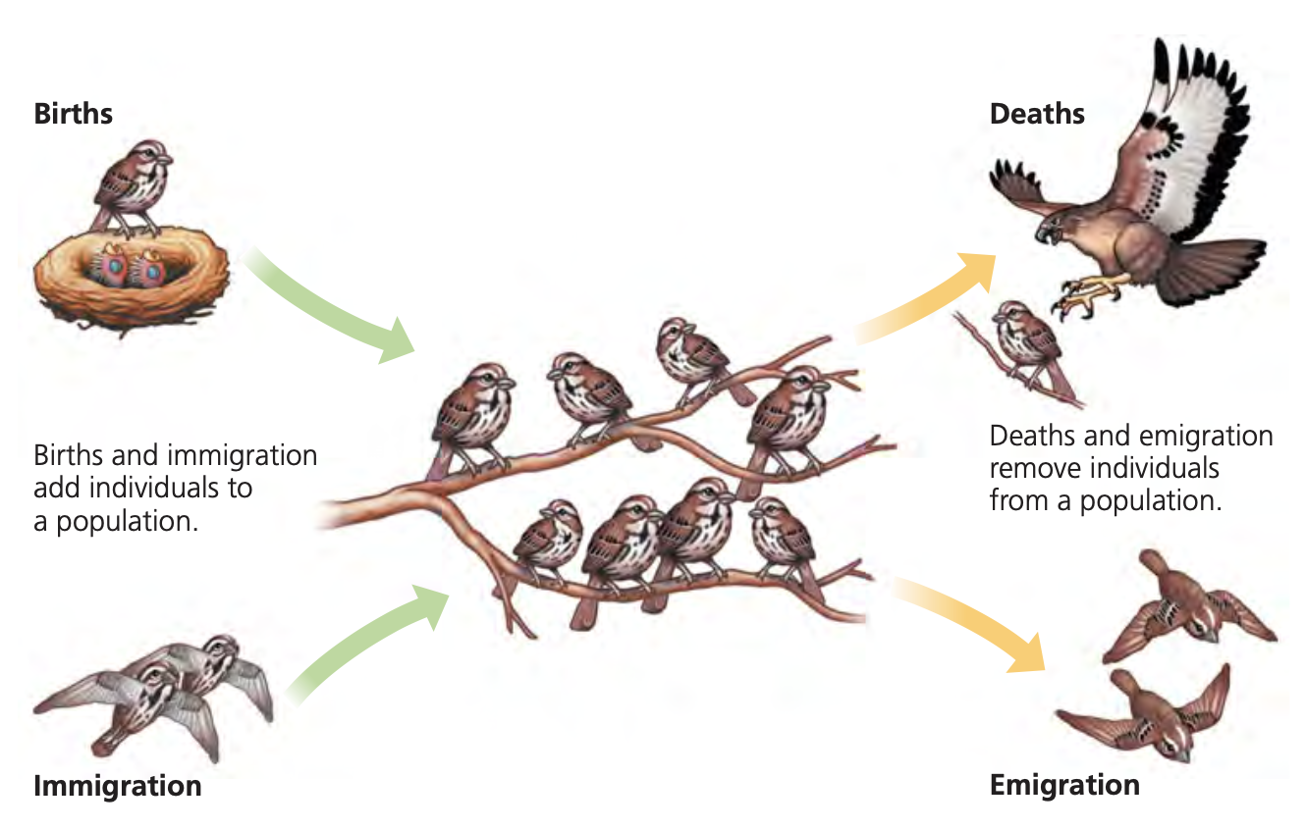
Density
Density: number of individuals per unit area or volume
Determining population size
Counting every individual
Sample and estimate total
Mark-recapture method
Population dynamics
Adds individuals
Birth
Immigration
Removes individuals
Mortality
Emigration

Slide 13
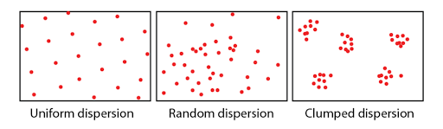
Dispersion
Dispersion: pattern of spacing among individuals
Clumped
plant, fungi
Uniform
Territoriality: defense of bounded physical space
Random
Absence of attraction or repulsion among individuals

Slide 14
Demography
Demography: study of statistics of populations and how they change over time
Life tables
Survivorship curves
Reproductive rates

Slide 15
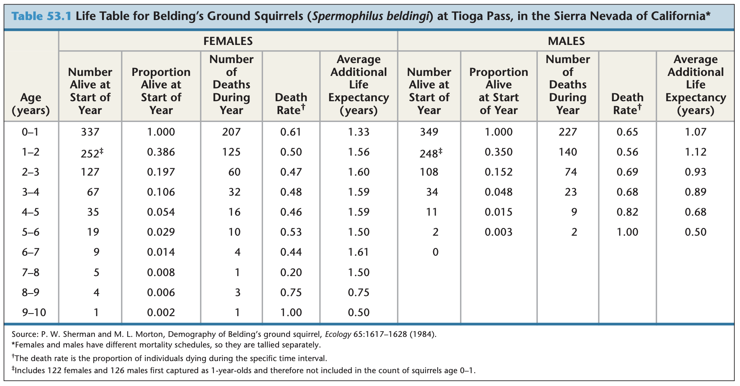
Life tables
Cohort: a group of individuals of the same age

Slide 16
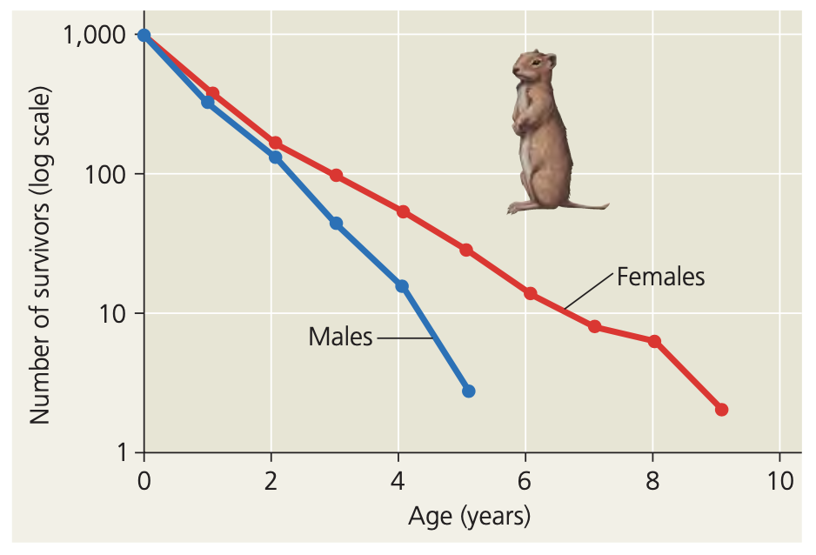
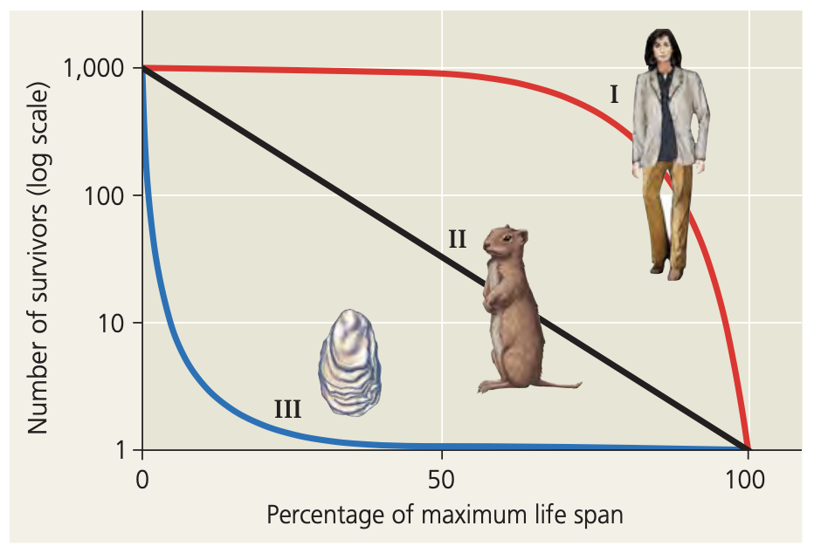
Survivorship curves
Type I (k-strategy): low death rate at start
Type II: constant death rate over span of lifetime
Type III (r-strategy): high death rate at young

Slide 17
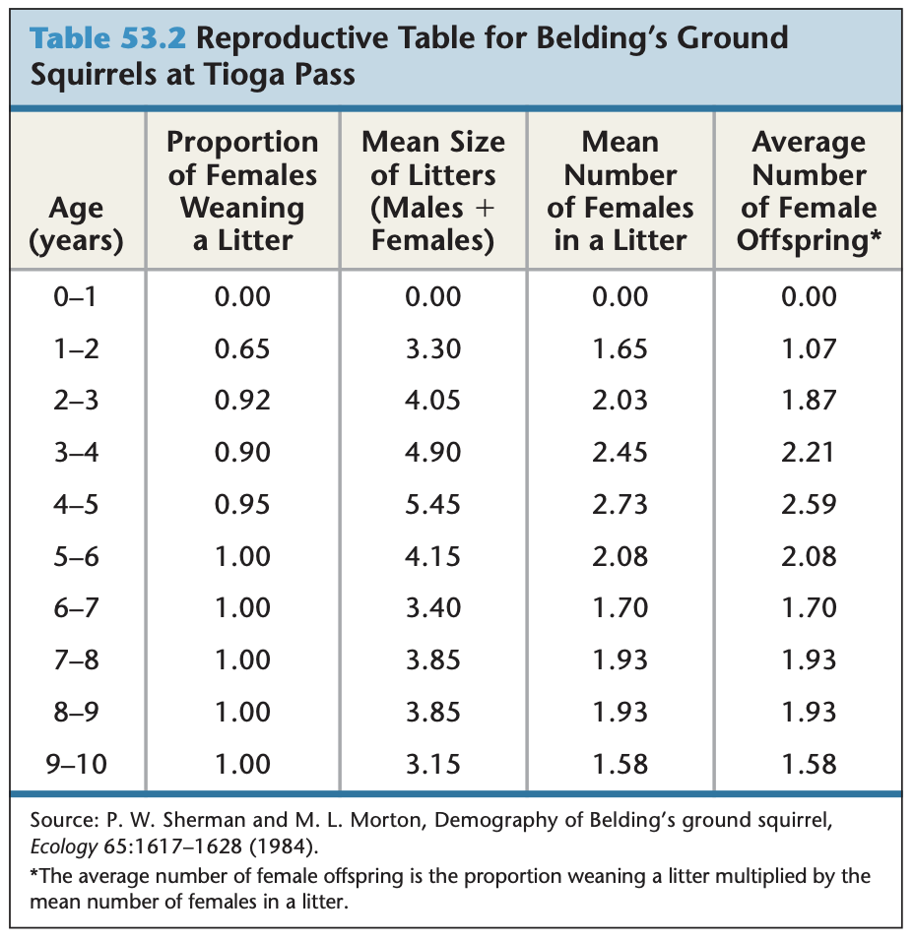
Reproductive rates
Reproductive table: age specific summary of reproductive rates
Focuses on females because only females produce offspring
Semelparity: organisms reproduce only once
survival rate of offspring low
Iteroparity: repeated reproduction
competition for resources intense

Slide 18
Population density
Density independent: birth/death rate does not change with population density
Density dependent: birth rate decreases, death rate increases as population density increases
Competition for resources
Territoriality
Health
Predation
Toxic waste
Intrinsic factors

Slide 19
Community Ecology

Slide 20
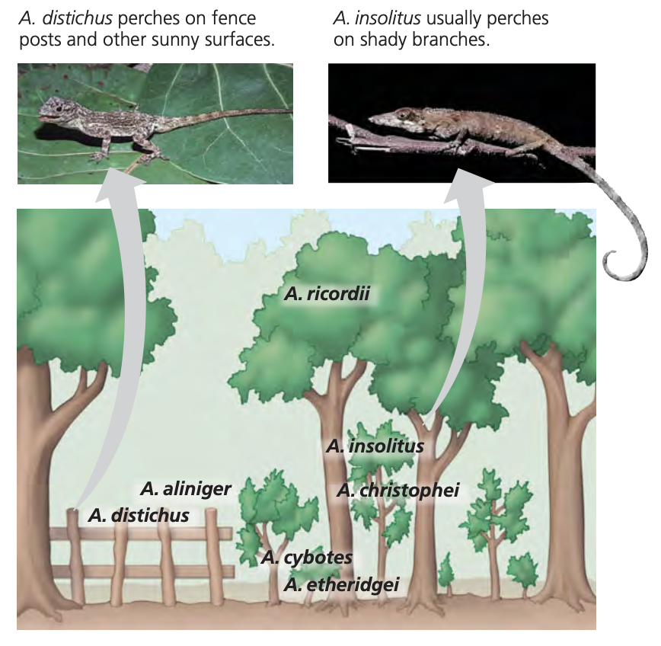
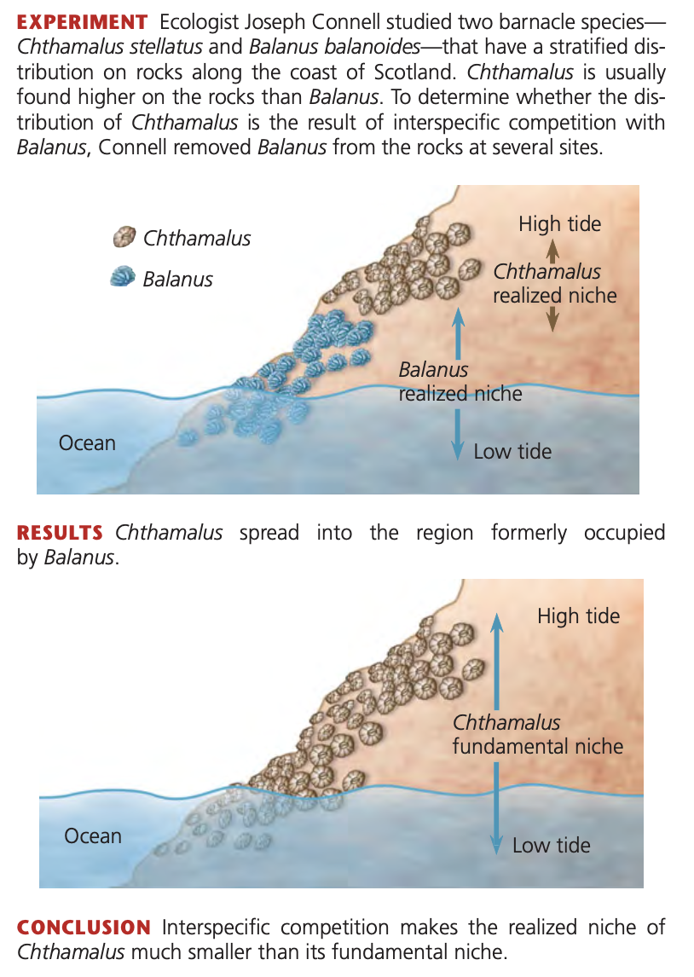
Competition
The competitive exclusion principle (Gause’s Law)
Ecological niche: species’ use of biotic and abiotic sources in environment
Fundamental niche: niche potentially occupied by species
Realized niche: niche that the species actually occupies
Resource partitioning: allows similar species to coexist in a community

Slide 21
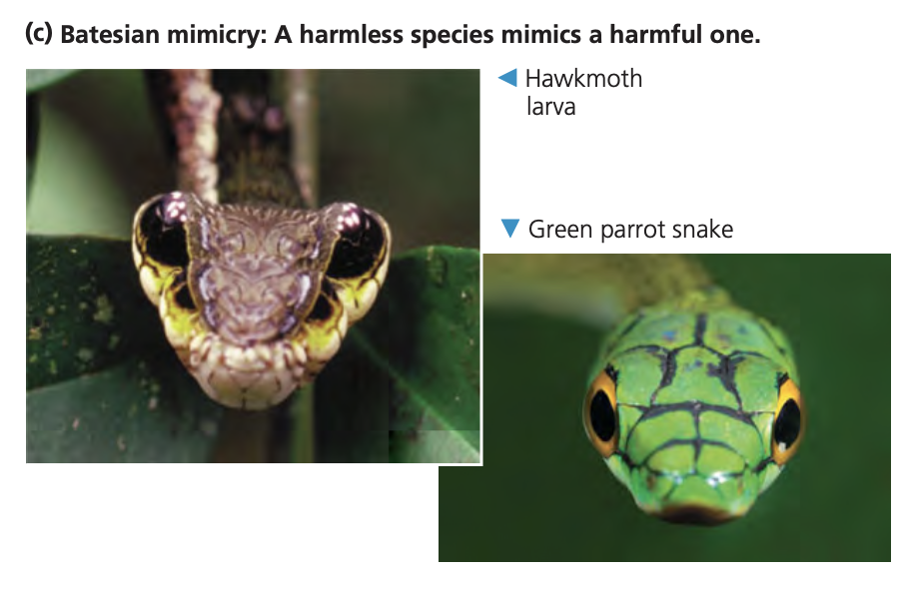
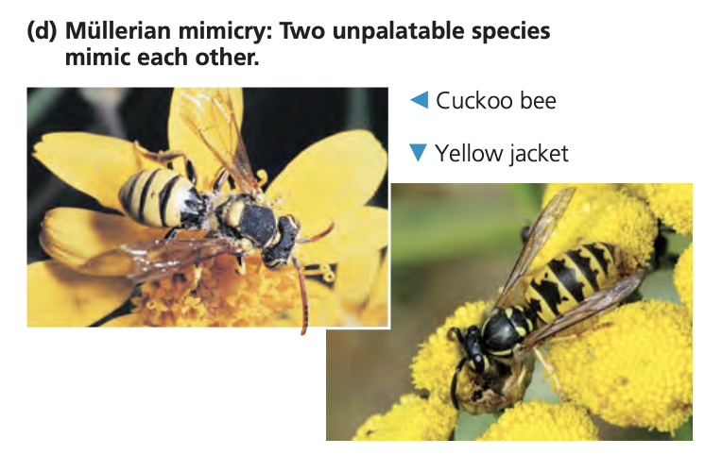
Coloration and mimicry
Coloration
Cryptic coloration: makes prey difficult to see
Aposematic coloration: warns predators through bright colors
Mimicry
Batesian mimicry: harmless species mimics harmful species
Müllerian mimicry: two harmful species mimic each other → “larger population”

Slide 22
Symbiosis and energy transfer
Symbiotic relationships
Parasitism: +/-
Mutualism: +/+
Commensalism: +/o
Trophic structure
Length of food chain limited by inefficiency of energy transfer between levels
10% of energy is transferred

Slide 23
Succession and GPP
Succession: disturbed area is gradually replaced by other species
Primary succession: if succession occurs where soil has not yet formed
Secondary succession: when soil is still intact after disturbance
Gross primary production (GPP): amount of light energy that is converted to chemical energy by photosynthesis per unit of time
Net primary production (NPP): GPP - energy used for respiration
NPP = GPP - R

Slide 24
Thank you!

